Slide 1
Chapter 18
Introduction to Cryptography

Slide 2
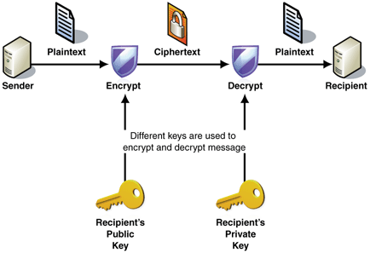
General Idea
BOB
ALICE

Slide 3
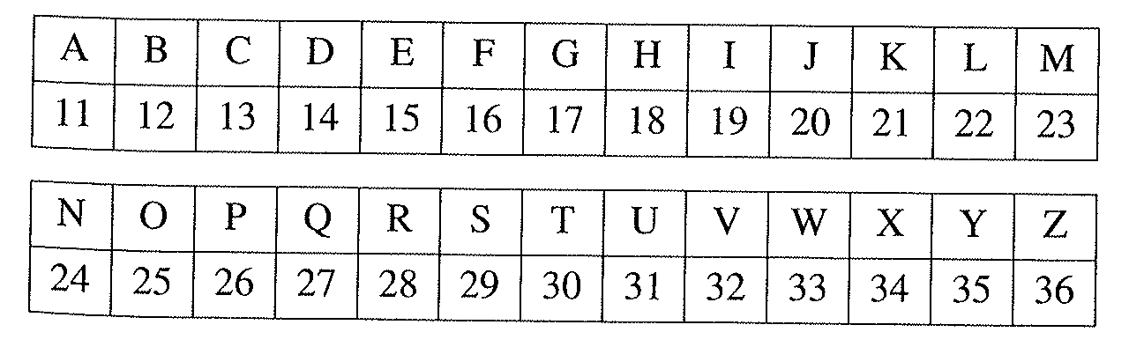
Encoding
Math is Cool
23113018192913252522
Ignore spaces, punctuation

Slide 4
Alice (receiver)
Select two large primes
p = 12553, q = 13007
Compute m = pq = 163276871 and φ(m) = (p-1)(q-1) = 163251312
Select k that is relatively prime to φ(m)
k = 79921
Publish m and k. Keep p and q secret.

Slide 5
Bob
Plaintext message = “To be or not to be”
30251215252824253030251215
Split message into chunks of eight digits
30251215, 25282425, 30302512, 15
(because m= 163276871 has nine digits – choose one less)

Slide 6
Bob - Encode
Raise each chunk to the k^{th} power mod m (successive squaring)
Ciphertext (send this to Alice):
149419241, 62721998, 118084566, 40481382

Slide 7
Comments
To encode, Bob needed m, k and his message
He did not need to know p and q.
What if Eve intercepts the message?
She would need to solve
Without knowing p and q, φ(163276871) is very difficult to compute (with m = 600 digits)

Slide 8
Alice - Decrypt
Alice receives the ciphertext:
149419241, 62721998, 118084566, 40481382
With knowledge of p and q, she can solve the congruences (Ch. 17):

Slide 9
Alice reveals the message
These congruences yield the solutions: 30251215, 25282425, 30302512, 15
30251215252824253030251215
“To be or not to be”

Slide 10
General Idea -RSA
BOB
ALICE
p and q
m and k

Slide 11
Encrypt your name (first and last name)
Use m = 37054937 (8 digits), k = 24151
Show all steps, but you may use Wolfram Alpha to calculate powers mod m.
Email me the encrypted message by Wednesday (11/6)
Ch 18: 1 (do without Wolfram Alpha..show all work)

